Slide 1
DE PROJECT PRESENTATION
Made by: Utsav Singh
2K20/IT/156

Slide 2
AUTOMATED ATTENDANCE SYSTEM
The goal of this project is to create an automated attendance system which can be used to automatically mark and store the attendance of DTU students in the form of excel sheets which can be easily accessed and modified.
The plan is to create a robust system where only DTU students of a specific batch attending a specific class can mark their attendance and there will be no way to cheat the system and get free attendance .

Slide 3
APPROACH
The program will have a menu sytem using the CLI and the user will be able to easily access all the features of the program.
First we will need the way to access the camera (webcam) of the computer and then use is to take pictures of the ID card when it is showed to the camera by the student. This will be done by the OpenCV module in python.
Pytesseract module will provide the ocr model that is light weight and fast and meets the requirements of this project.
Finally Openpyxl module is used to deal with the excel side of things.

Slide 4
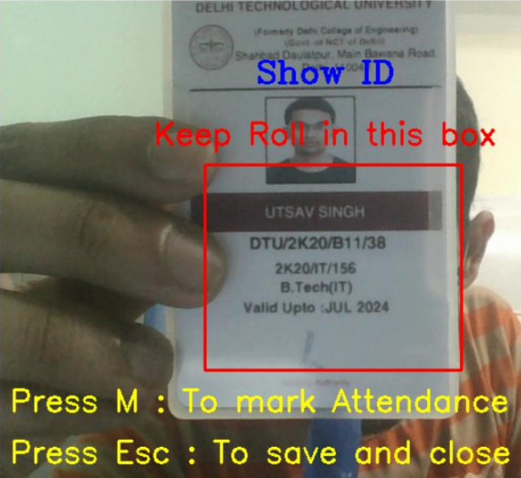
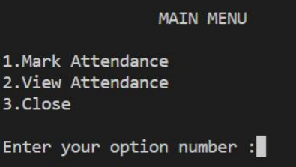
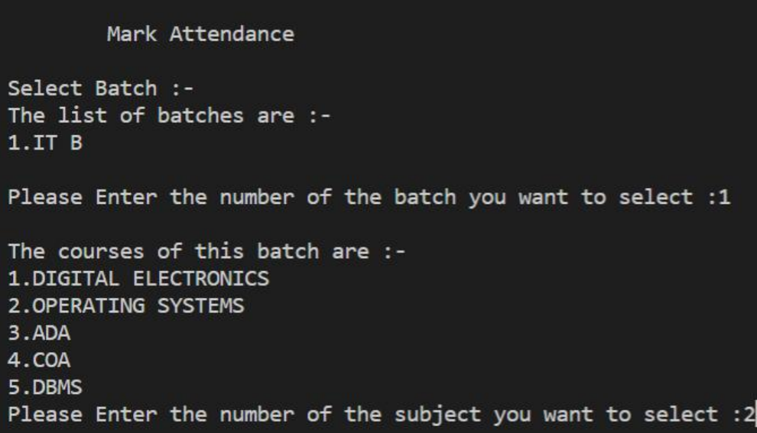

SOME SCREENSHOTS OF WORKING PROGRAM

Slide 5
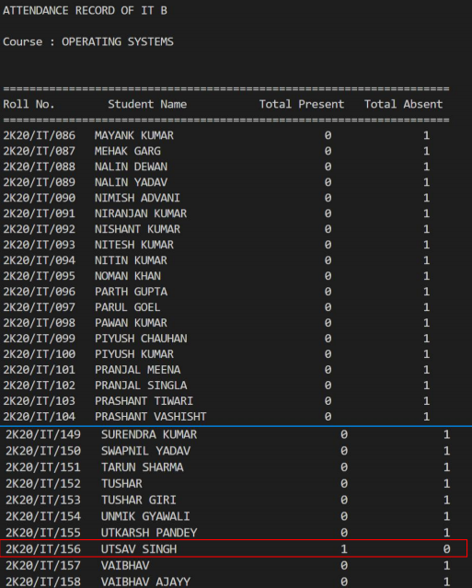
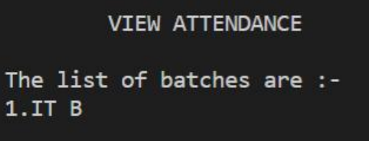
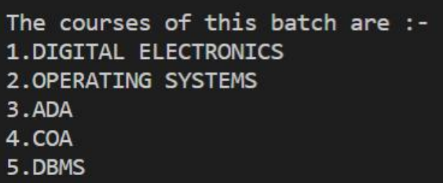
MORE SCREENSHOTS

Slide 6
FUTURE SCOPE
1. Making the program more advance by using face detection to match the photo in the ID to the one showing the ID.
2. Improving the UI and making it more pleasing to look at.
3. Making a web version that can work on both computers and mobile phones to make the program more portable.

